Slide 1
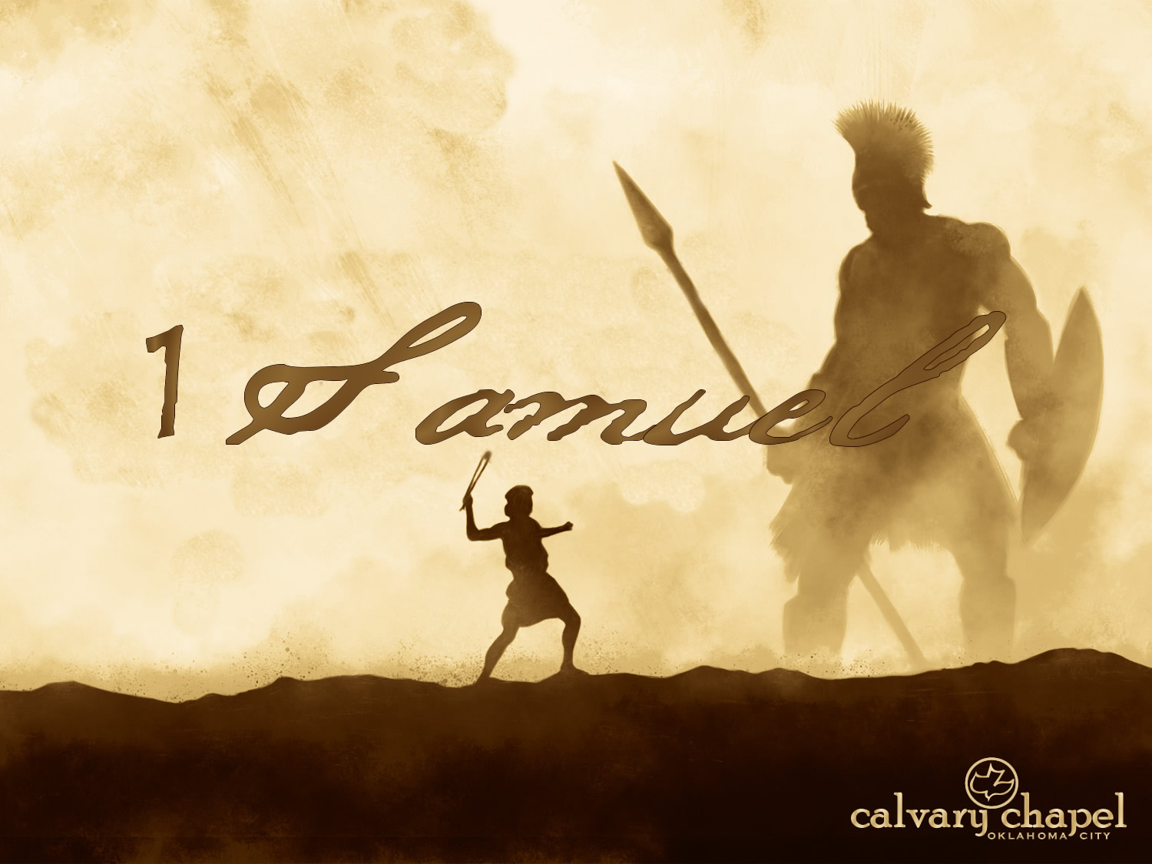

A CD of this message will be available (free of charge) immediately following today's message
This message will be available via podcast later this week at calvaryokc.com
27-28

Slide 2
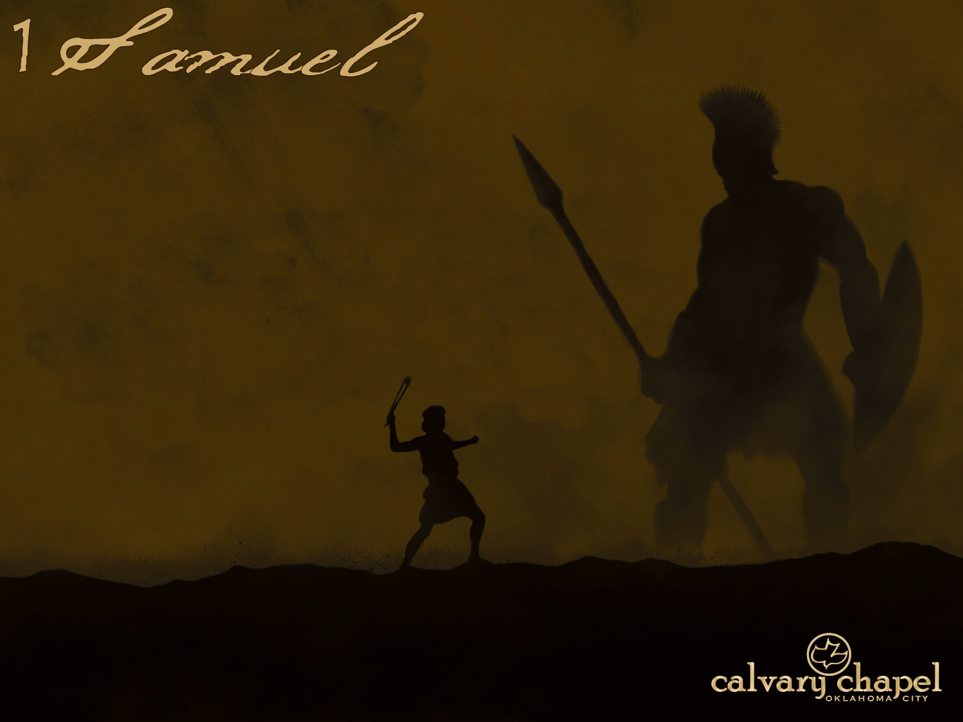
27-28
William Law (1686-1761), The Spirit of Prayer ~ "Consider yourself as always wrong, as having gone aside, and lost your right path, when any delight, desire, or trouble, is suffered to live in you, that cannot be made a part of this prayer of the heart to God. For nothing so infallibly shows us the true state of our heart, as that which gives us either delight or trouble; for as our delight and trouble is,

Slide 3
27-28
so is the state of our heart: if therefore you are carried away with any trouble or delight, that has not an immediate relation to your progress in the divine life, you may be assured your heart is not in its right state of prayer to God."

Slide 4
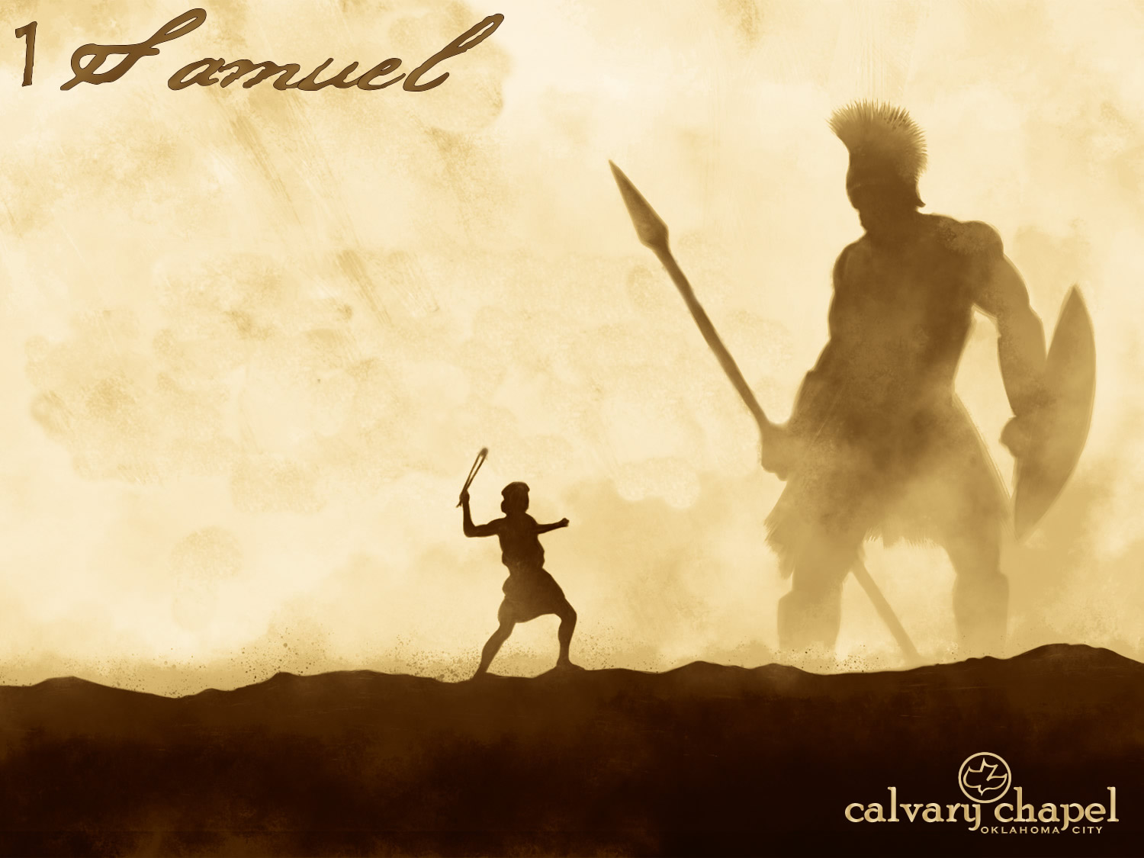
27-28

Slide 5
27-28
G. Campbell Morgan ~ "It is impossible to see David taking refuge in Gath, without recognizing that he had lost for the time being the clear vision of God which made him strong against Goliath."

Slide 6
27-28

Slide 7
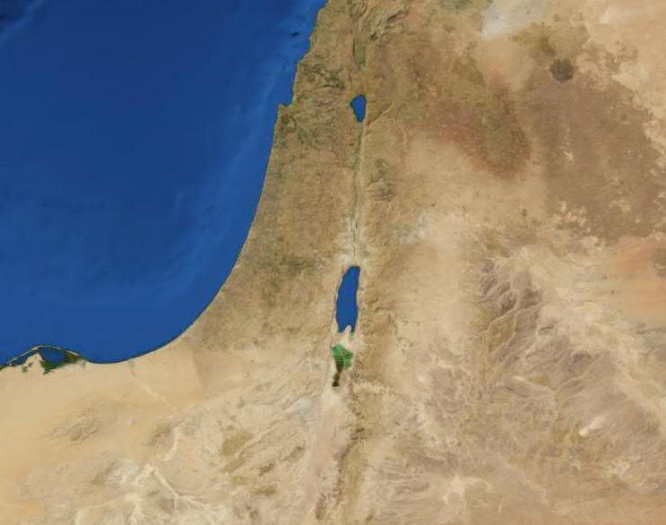
27-28
Judah
Ziklag

Slide 8
27-28

Slide 9
27-28
1 Chron. 10:14 ~ But he did not inquire of the Lord; therefore He killed him, and turned the kingdom over to David the son of Jesse.

Slide 10
27-28
Judges 10:14 ~ Go and cry out to the gods which you have chosen; let them deliver you in your time of distress.

Slide 11
27-28
Jer. 2:23–28 (NLT) ~ ²³ “You say, ‘That’s not true!
I haven’t worshiped the images of Baal!’
But how can you say that?
Go and look in any valley in the land!
Face the awful sins you have done.
You are like a restless female camel
desperately searching for a mate.
²⁴ You are like a wild donkey,
sniffing the wind at mating time.
Who can restrain her lust?

Slide 12
27-28
Those who desire her don’t need to search,
for she goes running to them!
²⁵ When will you stop running?
When will you stop panting after other gods?
But you say, ‘Save your breath.
I’m in love with these foreign gods,
and I can’t stop loving them now!’

Slide 13
27-28
²⁶ “Israel is like a thief
who feels shame only when he gets caught.
They, their kings, officials, priests, and prophets—
all are alike in this.
²⁷ To an image carved from a piece of wood they say,
‘You are my father.’
To an idol chiseled from a block of stone they say,

Slide 14
27-28
‘You are my mother.’
They turn their backs on me,
but in times of trouble they cry out to me,
‘Come and save us!’
²⁸ But why not call on these gods you have made?
When trouble comes, let them save you if they can!
For you have as many gods
as there are towns in Judah.”

Slide 15
27-28
Is. 57:13a ~ When you cry out,
Let your collection of idols deliver you.

Slide 16
27-28

Slide 17
27-28
Spirit ~ elohim
– NASB, divine being

Slide 18
27-28

Slide 19
27-28
Why would God bring Samuel back?
1) Make Saul's crime an instrument of his punishment
2) Show God's superiority to the heathen
3) Demonstrate life after death

Slide 20
27-28

Slide 21
27-28
Author unknown
Double ~ KJV, worthy
Tabernacle ~ hēkal – NIV, NASB ~ Temple – the sense of a large public place

Slide 22
27-28

